Slide 1
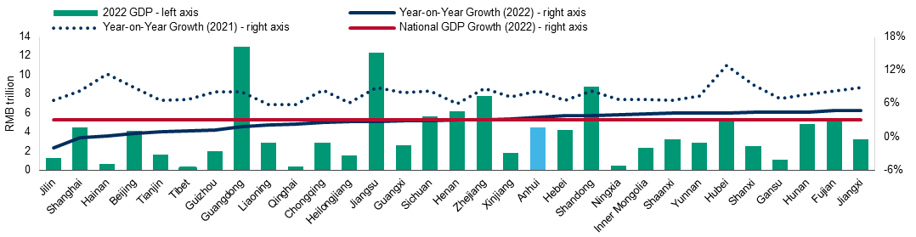
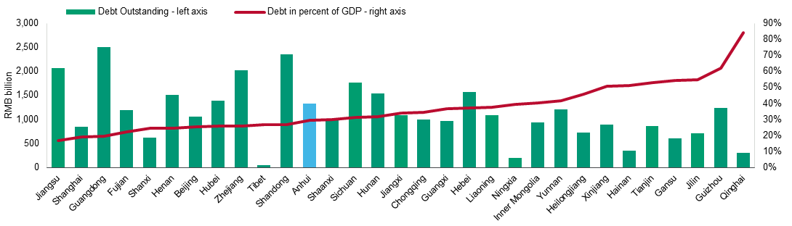
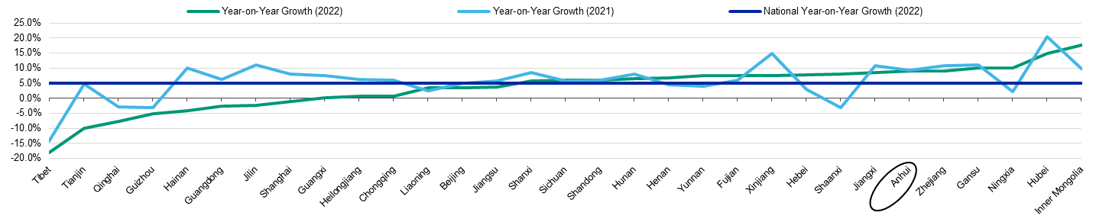
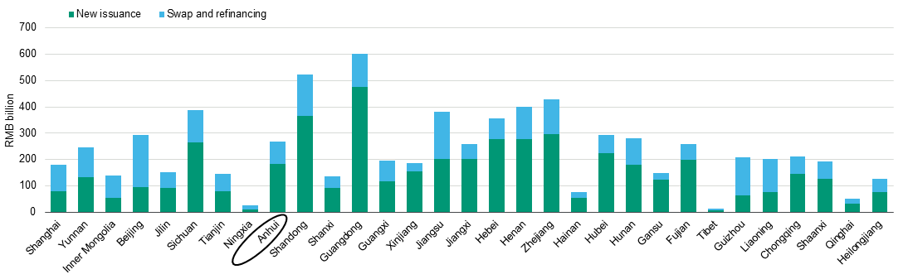
Overview on Province of Anhui (China)
Anhui is situated in eastern China (A1 stable) and is part of the highly developed Yangtze River Delta Economic Zone. Anhui borders the provinces of Henan, Hubei, Jiangsu, JiangXi, Shandong and Zhejiang. The Huai River and the Yangtze River both flow through the province. The provincial capital of Hefei is the most
populous city in Anhui, and is the economic, political and cultural center of the province. Anhui is the ninth most populous province and also recorded 10th highest GDP among Chinese provinces as of year-end 2022.
Key Metrics of the Province of Anhui
Population: 61.3 million inhabitants
Capital: Hefei city
Nominal GDP: RMB4.5 trillion ($669.6 billion)
Share in China’s GDP: 3.7%
Real GDP growth: 3.5%
Foreign trade: $113 billion
Source: National and provincial statistics offices, provincial finance departments, the Ministry of Finance and Moody's Investors Service
Regional peer comparison – Real GDP growth
Regional peer comparison – Debt to GDP
Regional peer comparison – Fixed assets investments
Regional peer comparison – General purpose and special purpose bonds issuance

Slide 2
Economic fundamentals
Public finance
Economy | 2020 | 2021 | 2022 | China average¹
Nominal GDP | 3,806 | 4,257 | 4,504 | 3,904
Real GDP growth | 3.7% | 8.2% | 3.5% | 3.0%
Total retail sales of consumer goods | 1,833 | 2,147 | 2,152 | 1,418
Fixed asset investment yoy growth (%) | 5% | 9% | 9% | 5%
o/w real estate development investment | 704 | 726 | 681 | 429
Total volume of foreign trade ($ billion) | 78 | 107 | 113 | 202
GDP per capita (RMB) | 62,411 | 69,676 | 73,603 | 85,698
Urban resident per capita disposable income (RMB) | 39,442 | 43,009 | 45,133 | 49,283
Public finance | 2020 | 2021 | 2022 | China average¹
General budgetary revenue | 322 | 350 | 359 | 351
o/w tax income ratio (%) | 68% | 68% | 63% | 70%
Government fund revenue | 314 | 352 | 309 | 238
o/w land sales proceeds | 286 | 324 | 282 | 211
General budgetary expenditure | 747 | 759 | 838 | 726
Government fund expenditure | 447 | 468 | 469 | 339

Slide 3
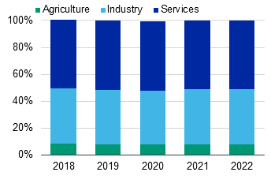
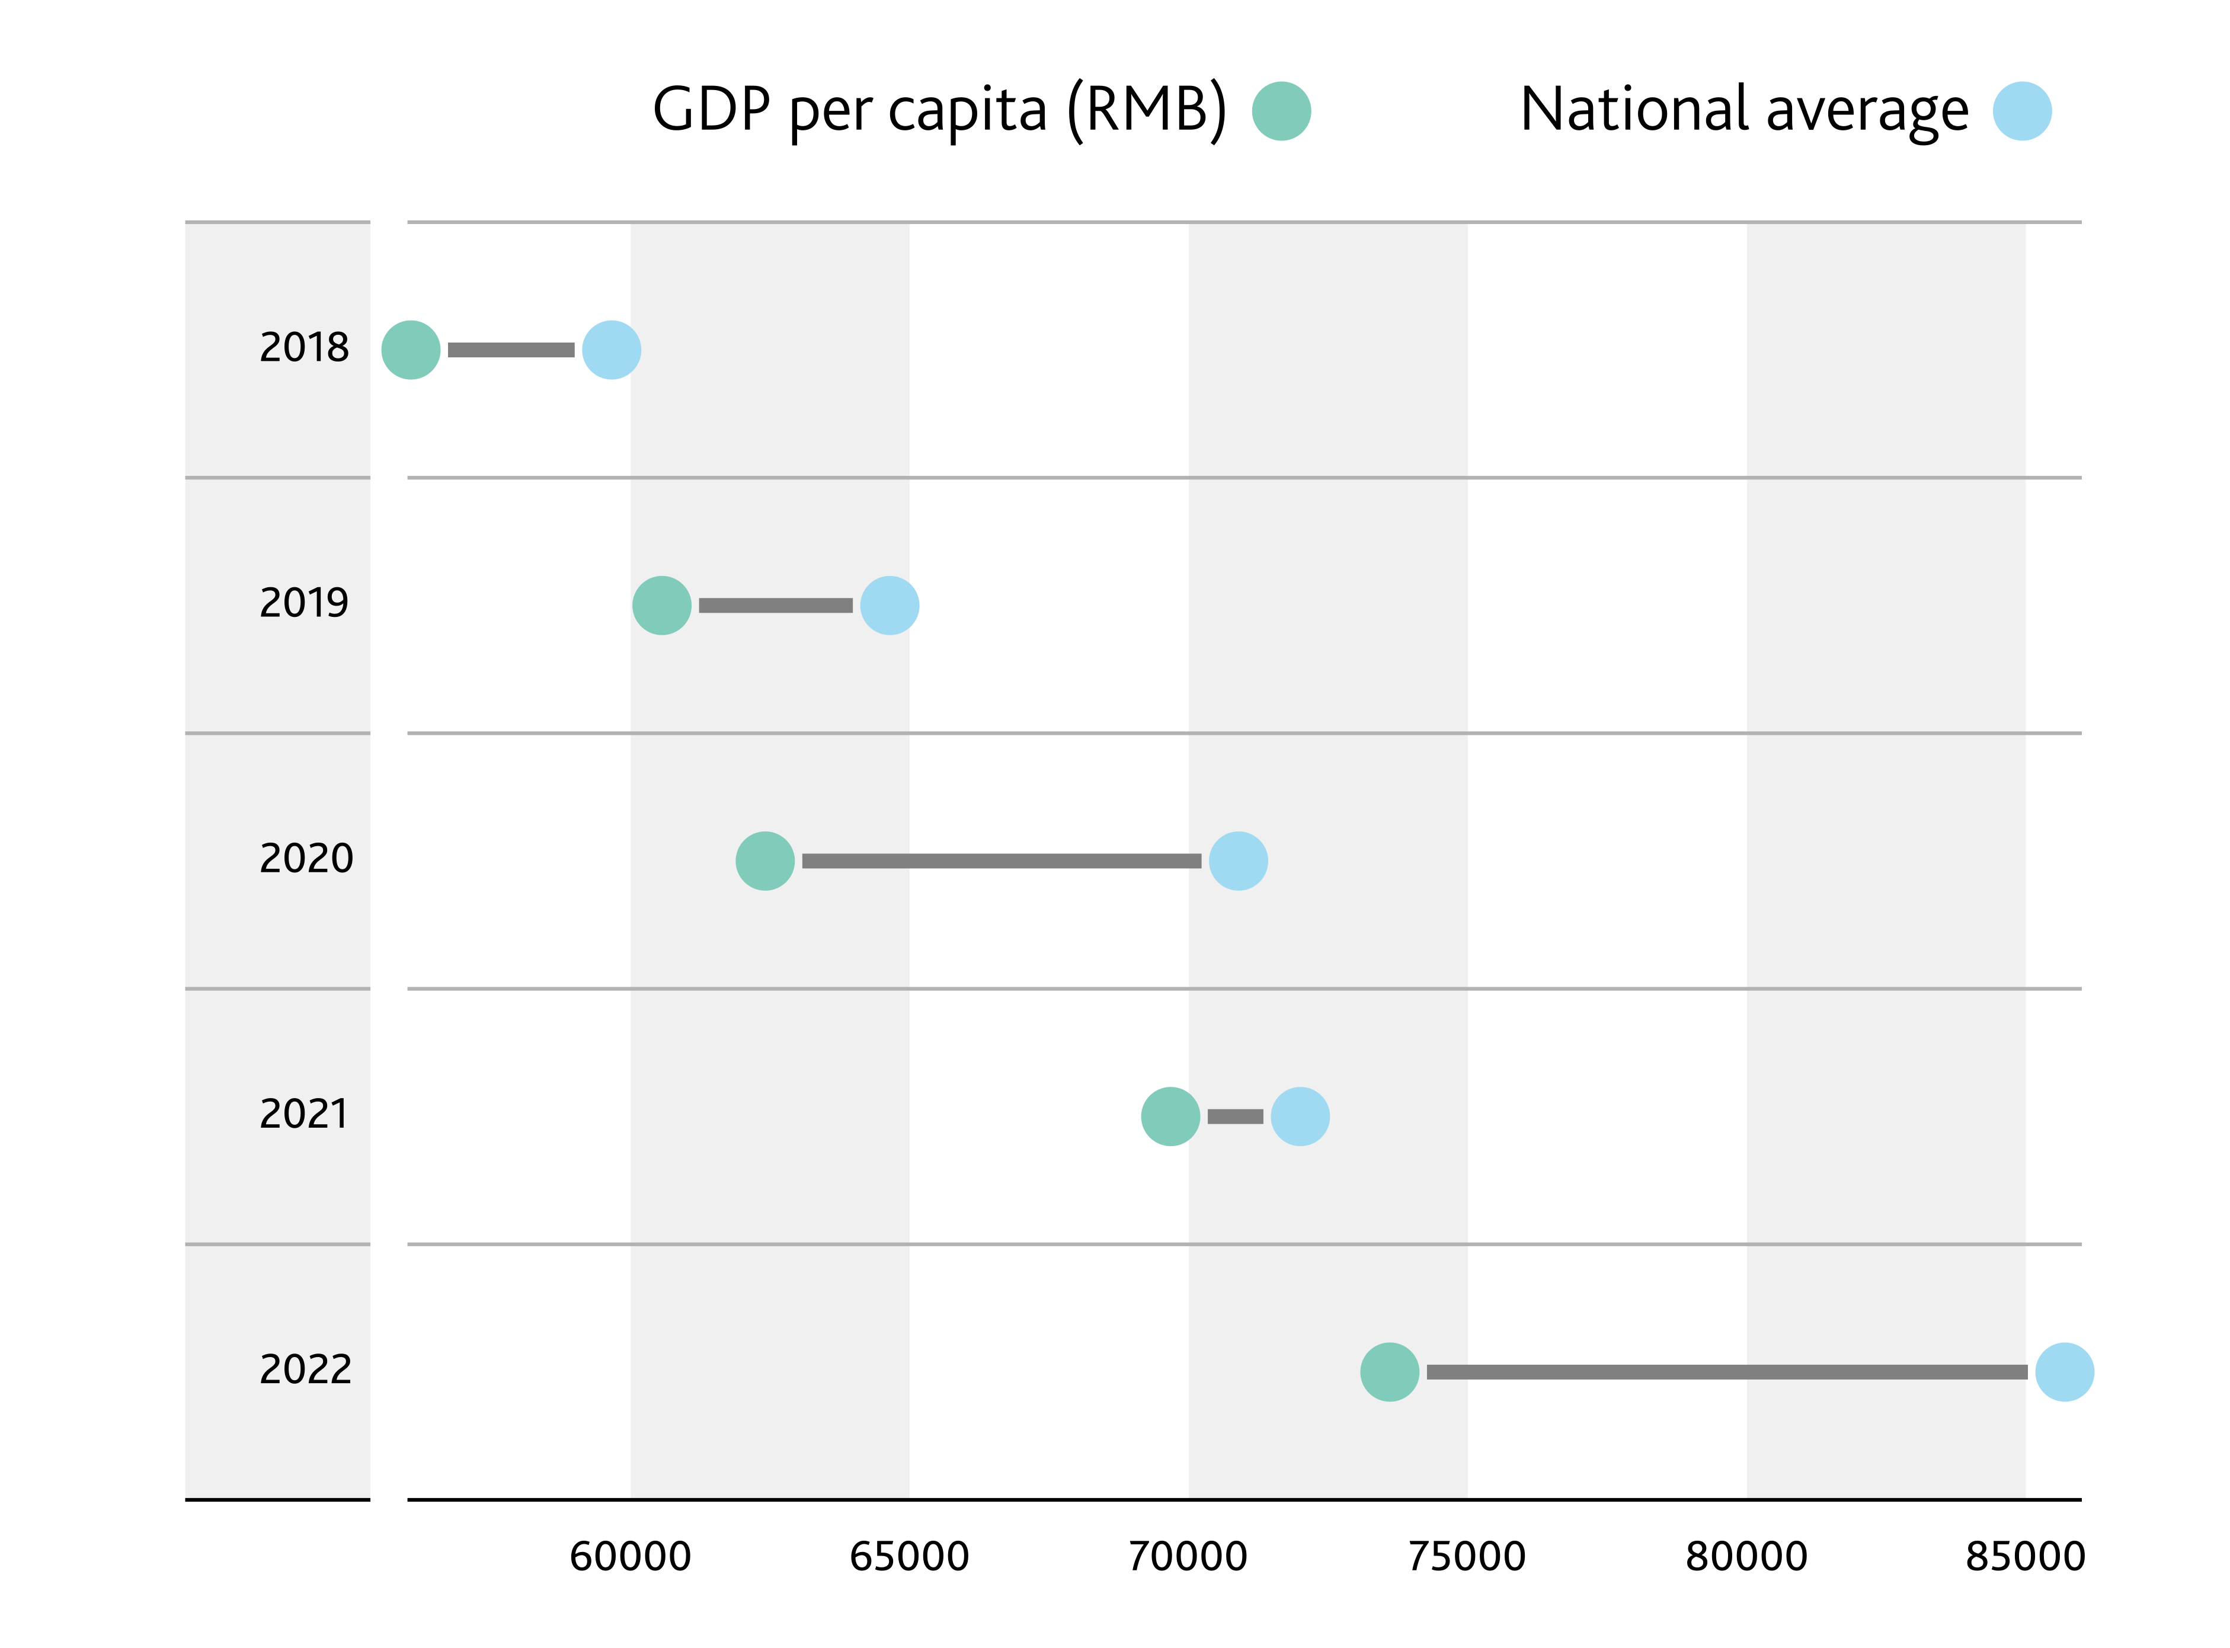
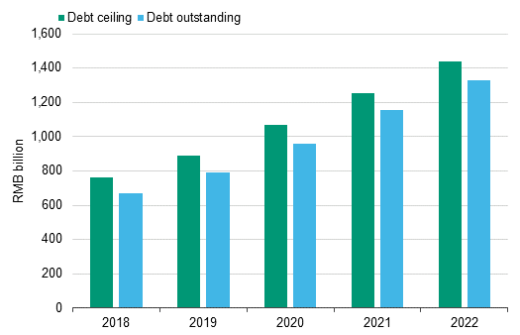
Sector contribution to GDP, 2018-2022
GDP per capita and national average
Debt ceiling and debt outstanding, 2018-2022

Slide 4
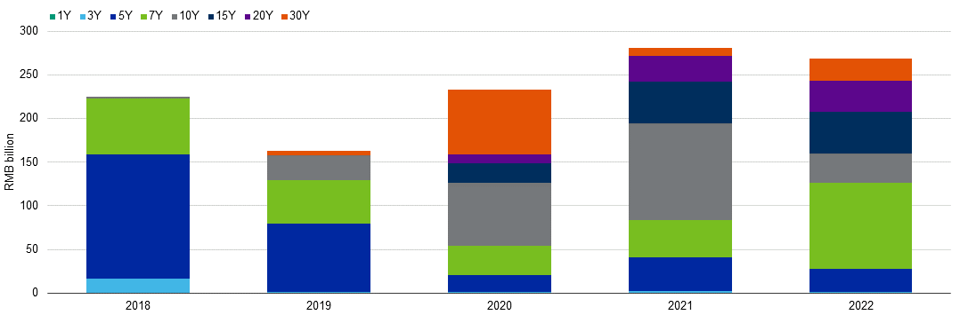
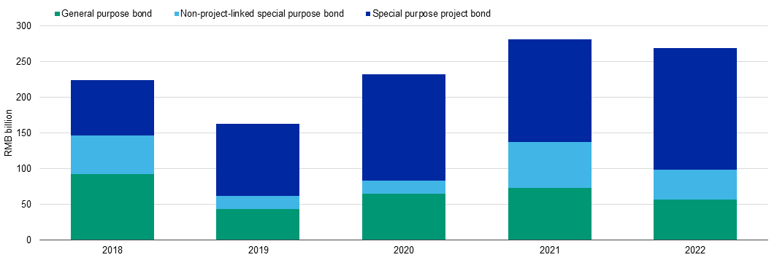
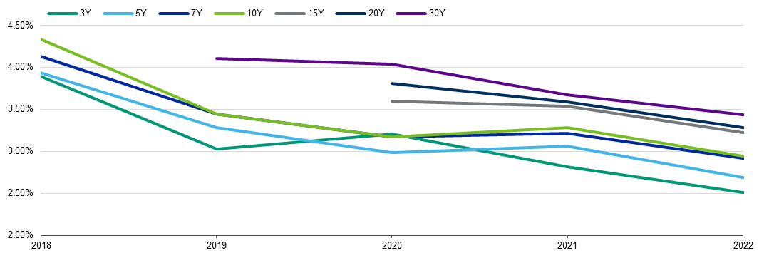
10 major cities in Anhui Province by GDP and per capita GDP in 2022
Onshore bond issuance, by tenor (2018-22)
Cities | Nominal GDP (RMB billion) | Contribution to Anhui's GDP | Per capita GDP (RMB)
Hefei city | 1201.3 | 27% | 125,798
Wuhu city | 450.2 | 10% | 121,630
Chuzhou city | 361.0 | 8% | 89,800
Fuyang city | 323.3 | 7% | 39,643
Anqing city | 276.7 | 6% | 66,470
Ma'anshan city | 252.1 | 6% | 116,100
Suzhou city | 222.5 | 5% | 41,875
Bozhou city | 210.2 | 5% | 42,258
Bengbu city | 201.2 | 4% | 60,739
Lu'an city | 200.5 | 4% | 45,643
Onshore bond issuance, by category (2018-22)
Onshore bond issuance, by coupon rate (2018-22)

Slide 5
Economic profile of cities in Anhui province

